Slide 1









Task 2 : Data preprocessing
Presented By Sama Alaa Abdelgwad

Slide 2
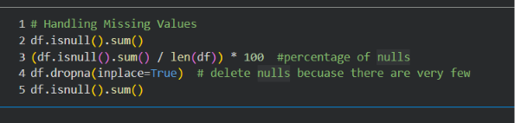
HANDLING MISSING VALUES
Data Quality Check – Missing Values
What we did:
Checked the number of missing values in each column.
Calculated the percentage of missing data.
Verified that the dataset contains no missing values.
Result:
All features had 0 missing values.
We delete them becuase there are few.

Slide 3


ENCODING CATEGORICAL VARIABLES
Converting Categorical Features into Numerical Format
What we did:
Removed unnecessary identifier columns:
User ID
User Name
Driver Name
Key
Pickup datetime
Applied different encoding techniques:
One-Hot Encoding for WeatherBecause weather categories have no natural order.
Ordinal Encoding for:
Traffic Condition
Car Condition
Because their categories have an order/ranking.
Result:
All categorical variables were converted into numerical values.
Dataset became ready for machine learning models.

Slide 4
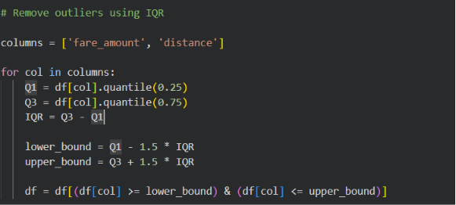
OUTLIER DETECTION & TREATMENT
Removing Extreme Values
What we did:
Detected outliers using the IQR (Interquartile Range) method.
Applied outlier removal on:
fare_amount
distance
Method:
Values outside:
Q1 − 1.5 × IQR
Q3 + 1.5 × IQR
were considered outliers and removed.

Slide 5


FEATURE SELECTION (RFE)
What we did:
Applied Recursive Feature Elimination (RFE) using Linear Regression.
Started with all available features.
The algorithm recursively removed less important features until selecting the top 10 features.
Selected Features:
Distance
Pickup & Dropoff coordinates
Time features:
Month
Weekday
Year
Location-related features:
LGA distance
Bearing
Why?
Reduces unnecessary features.
Helps the model focus on the most informative variables.
Can improve model efficiency and reduce complexity.

Slide 6
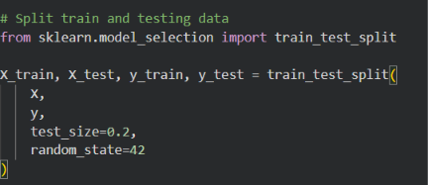
TRAIN-TEST SPLIT
Splitting the Dataset
Purpose:
To evaluate how well the model performs on unseen data.
Approach:
Training set: 80%
Testing set: 20%
Random state = 42 for reproducibility
Result:
The model was trained on the training data and evaluated on the test data.

Slide 7
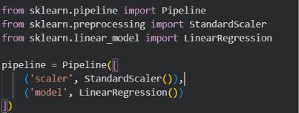
PIPELINE & FEATURE SCALING
Purpose
To automate preprocessing and model training in a single workflow.
Approach
Used StandardScaler to standardize all numerical features.
Combined the scaler and the Linear Regression model using Pipeline.
Why Pipeline?
Applies the same preprocessing during both training and testing.
Reduces the risk of data leakage.
Makes the workflow cleaner and easier to save and reuse.

Slide 8

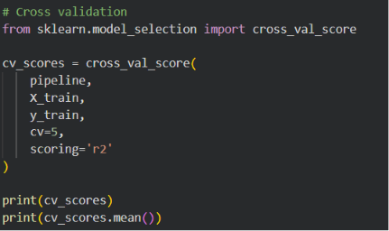

CROSS VALIDATION
Purpose
To evaluate the model's performance on different subsets of the training data and ensure it generalizes well.
Approach
Applied 5-Fold Cross Validation.
Used R² Score as the evaluation metric.

Slide 9

HYPERPARAMETER TUNING
Purpose
To improve model performance by finding the optimal value of the Ridge regularization parameter (alpha).
Approach
Used GridSearchCV with 5-Fold Cross Validation.
Tested different values of alpha:
0.001, 0.01, 0.1, 1, 10, 100, 500, 1000
Best Result
Best alpha = 1
Best CV R² = 0.6718

Slide 10
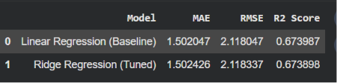

COMPARE BEFORE AND AFTER TUNNING
The tuned model achieved almost identical performance to the baseline model.
Hyperparameter tuning did not significantly improve the results.
This indicates that the Linear Regression model was already well-fitted for this dataset.

Slide 11

Thank You

